Slide 1

ESB – Overview
Phani Krishna

Slide 2
ESB – What is it ? Definitions
In computing, an enterprise se2rvice bus (ESB) is a software architecture construct which provides fundamental services for complex architectures via an event-driven and standards-based messaging engine (the bus). Developers typically implement an ESB using technologies found in a category of middleware infrastructure products, usually based on recognized standards.
Gartner - An ESB acts as a shared messaging layer for connecting applications and other services throughout an enterprise computing infrastructure. It supplements its core asynchronous messaging backbone with intelligent transformation and routing to ensure messages are passed reliably. Services participate in the ESB using either web services messaging standards or the Java Message System (JMS).
An enterprise service bus (ESB) is a software architecture for middleware that provides fundamental services for more complex architectures. For example, an ESB incorporates the features required to implement a service-oriented architecture (SOA).

Slide 3
Still not clear
There were lots of terms used in the above definitions and also there is no fixed definition for ESB.
Integration,product,architecture pattern, re-usable components,SOA, middleware,light weight , embeddable, J2EE , spring embeddable , web- services,BPEL,routing,workflows,reliable,service orchestration etc.
We will learn now what are the capabilities that an ESB can provide and then can comprehend what exactly an ESB is?
Knowing the exact business needs of an organization and then choosing the apt one among different ESB vendors/providers is a viable option.

Slide 4
Features of ESB
A communication bridge between client applications and service providers. ( Decouples client and service providers ).
Why should we decouple ? due of infrastructure services - application has to know how to communicate , route to service provider. If we point to a different service provider, then we need to change the client application as well.
Service location transparency.
Shares services across.
Business services vs Implementation services. ESB maps business services to implementation services.

Slide 5
Capabilities of an ESB
Routing ( what type of routing - Rule based , Policy based etc ).
Protocol Transformation ( Ex - HTTP to JMS , JMS to IIOP -
  seamlessly transform the sender’s message protocol to the receiver’s message protocol ).
Service mapping ( Business services to Implementation services ).
Process Choreography ( Co-ordination of multiple business services ).
Transaction management ( Compensation of activities when there is an issue ).
Security ( what type of security – Role based , Policy,SAML tokens etc).
Message Transformation ( Ex – SAP IDOC to XML , custom encoders –
  convert the structure and format of a message to match the requirements of the receiver).
Message enhancement ( Ex – Timestamp conversions etc -
  modify or add to a sender’s message to match the content expectations of the receiver ).
Message Processing ( Persistent , Non – persistent –
  ability to accept a service request and ensure delivery of either the message of a service provider or an error message back to the sender ).
Service orchestration ( Co-ordination of multiple implementation services).

Slide 6
Need to provide all ?
Atleast 5-6 capabilities defined should be supported to call itself as an ESB.
An ESB has to provide at least Message transformation , message enhancement , message processing , service orchestration , routing capabilities.
Depending upon the nature of our business,we can underplay some of the supported capability plug-ins to make it a light-weight ESB.

Slide 7
Architecture components
Mediator - (Serves as the entry point for all messages and has by far the largest number of message management responsibilities. It is responsible for routing, communication, message transformation, message enhancement, protocol transformation, message processing, error handling, service orchestration, transaction management, and access control (security) ).
Service Registry - ( Service Mapping information i.e., the location and binding of each service to the Mediator . Ex – UDDI etc ).
Process Choreography ( Usually implemented using BPEL - - responsible for the coordination of complex business processes that require the participation of multiple service providers )
Rules Engine ( Rules based , Policy based etc –
  provides the logic that is required for the routing, transformation and enhancement of messages )
Mediators are very fast and choreographers are slow as they need to log their state in case of failure. Also choreographers take some time because of extra layers involved for messaging.

Slide 8
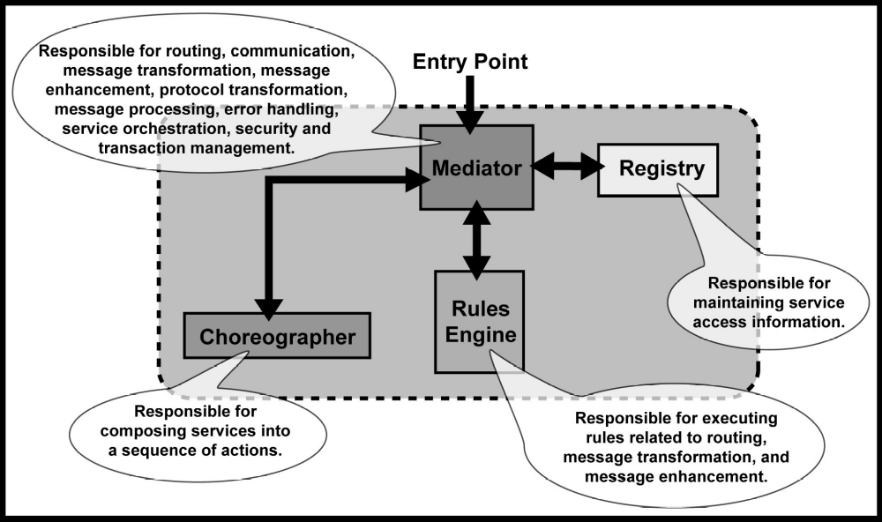
ESB Implementation - Mostly

Slide 9
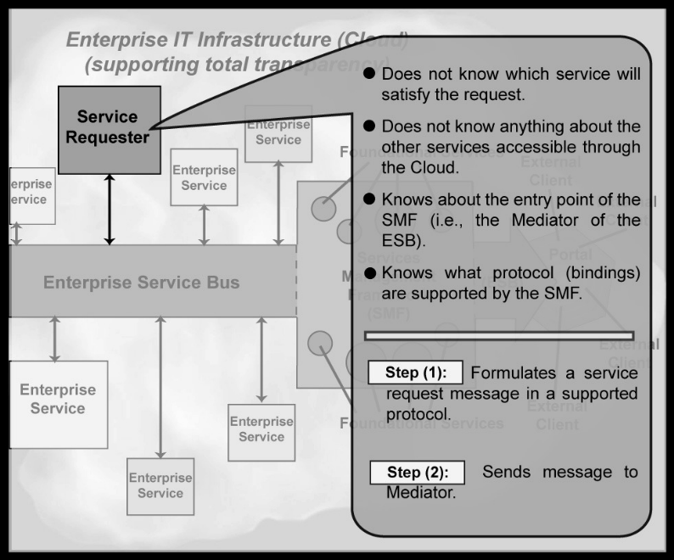
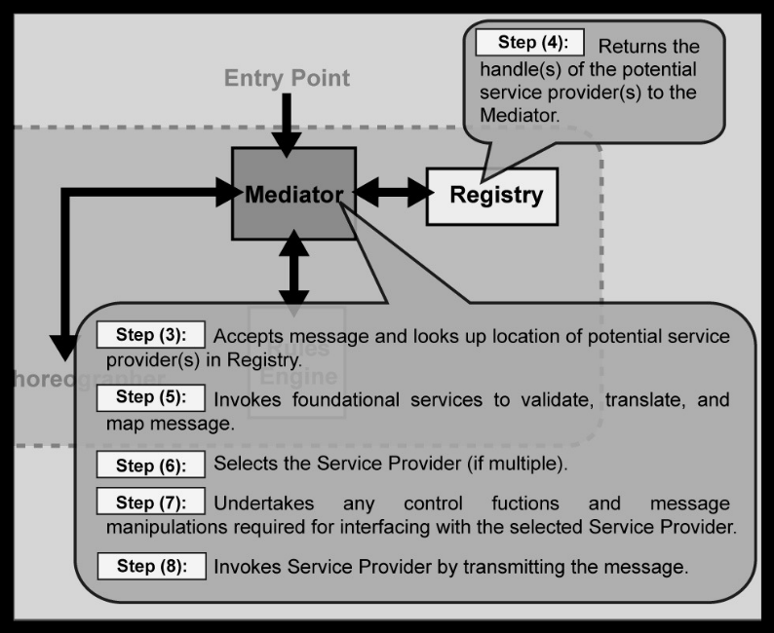
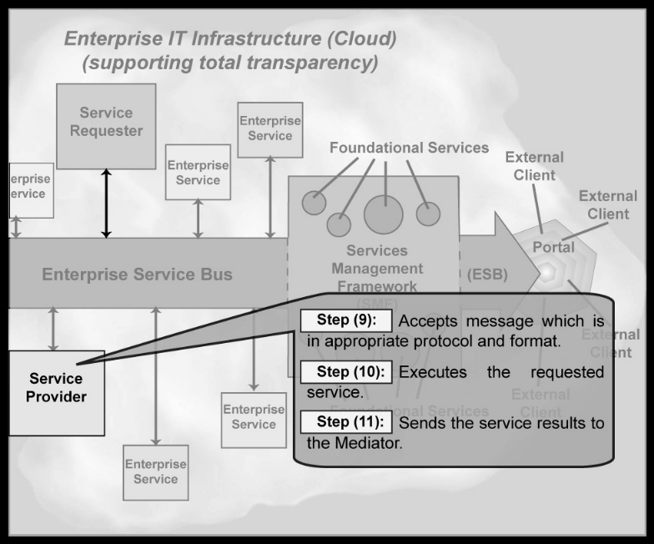
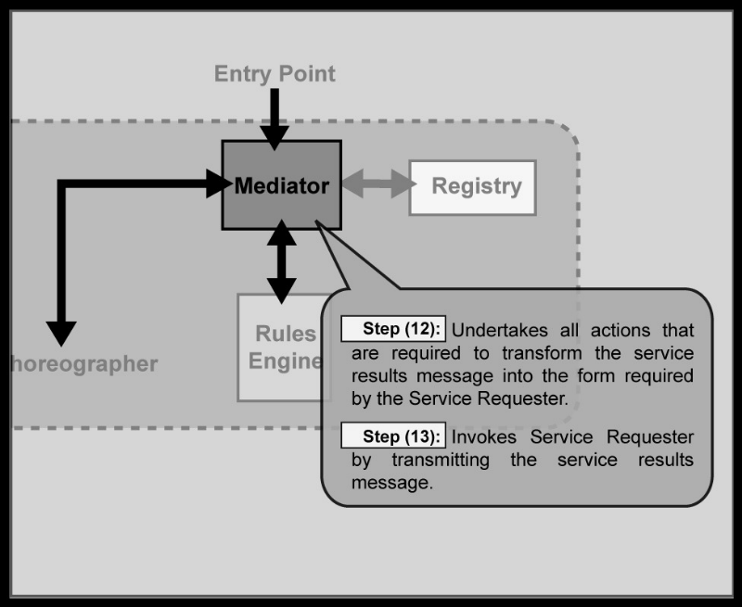
Notes:
Service Requester and Service Provider Scenario

Slide 10
SOA / EAI / ESB
SOA
  Service oriented architecture is approach to have software resources in an enterprise available and discoverable on network as well defined services.
  Each service would achieve a predefined business objective and perform discrete units of work.
  The services are independent and do not depend on the context or state of the other services.
  They work within distributed systems architecture.
  Earlier SOA used COM or ORB based on CORBA specifications and recent SOA stress on web services using standard description (WSDL), discovery (UDDI) and messaging (SOAP).
  Service oriented architecture may or may not use web services but yes web services provide a simple way towards service oriented architecture albeit with the age old security and reliability limitations.

Slide 11
EAI
EAI
- Enterprise application integration is a business need to make diverse applications in an enterprise including partner systems to communicate to each other to achieve a business objective in a seamless reliable fashion irrespective of platform and geographical location of these applications.
- It is a business need and business never dies it only evolves.
- EAI comprises of message acceptance, transformation, translation, routing, message delivery and business process management. Usually messages transportation is asynchronous but for a business need it can be synchronous as well.
- There are two basic architectures to achieve this, bus and hub/spoke architecture. Both of these can be used to develop services and then it also becomes service orientated architecture.

Slide 12
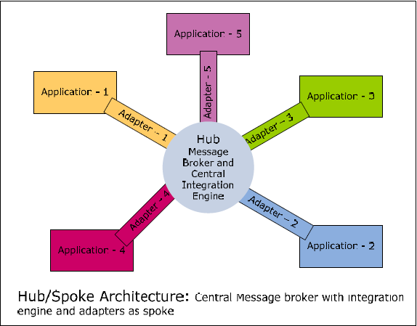
EAI - HUB/SPOKE
Notes:
Hub/Spoke architecture uses a centralized broker (Hub) and adapters (Spoke) which connect applications to Hub. Spoke connect to application and convert application data format to a format which Hub understands and vice versa. Hub on the other hand brokers all messages and takes care of content transformation/translation of the incoming message into a format the destination system understands and routing the message. Adapters take data from source application and publish messages to the message broker, which, in turn, does transformation/translation/routing and passes messages to subscribing adapter which sends it to destination application(s).

Slide 13
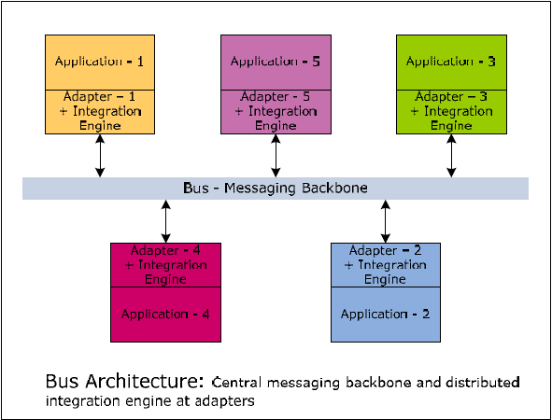
EAI - BUS
Notes:
Bus architecture uses a central messaging backbone (bus) for message propagation. Applications would publish messages to bus using adapters. These messages would flow to subscribing applications using message bus. Subscribing applications will have adapters which would take message from bus and transform the message into a format required for the application.
Key difference between hub/spoke and bus topology is that for the bus architecture, the integration engine that performs message transformation and routing is distributed in the application adapters and bus architecture requires an application adapter to run on the same platform as the original applications.
Since adapters have integration engine and run on same platform on which source and target applications run, this scales much better and is complex to maintain compared to hub/spoke topology.

Slide 14
ESB – Conclusion
Enterprise service bus is an infrastructure to facilitate SOA. It gives API which can be used to develop services and makes services interact with each other reliably.
Technically ESB is a messaging backbone which does protocol conversion, message format transformation, routing, accept and deliver messages from various services and application which are linked to ESB.
Difference between ESB and bus based implementations.
  Actually there is not much difference between ESB and proprietary buses except for a few subtle ones.
  Main difference between ESB and proprietary bus implementation is of cost which is significantly low for ESB. Reason for this cost difference is two fold, first proprietary bus offers lot of built in functionalities as a suit of product which need to be developed for ESB implementations based on business requirement, second most proprietary buses use some proprietary formats to enhance the performance and that increases the cost.
  ESB on the other hand is usually standard based, so it is a trade off between performance and cost between proprietary bus and ESB.
  Main advantage of ESB is that it costs much less then hub/spoke or bus based product suits and that it is standard based.

Slide 15


